Slide 1

Network Notification for Traffic Engineering and Load Balancing at Network Boundaries
Luis M. Contreras (Telefónica)
IETF 123, FANTEL BoF, Madrid, July 2025

Slide 2
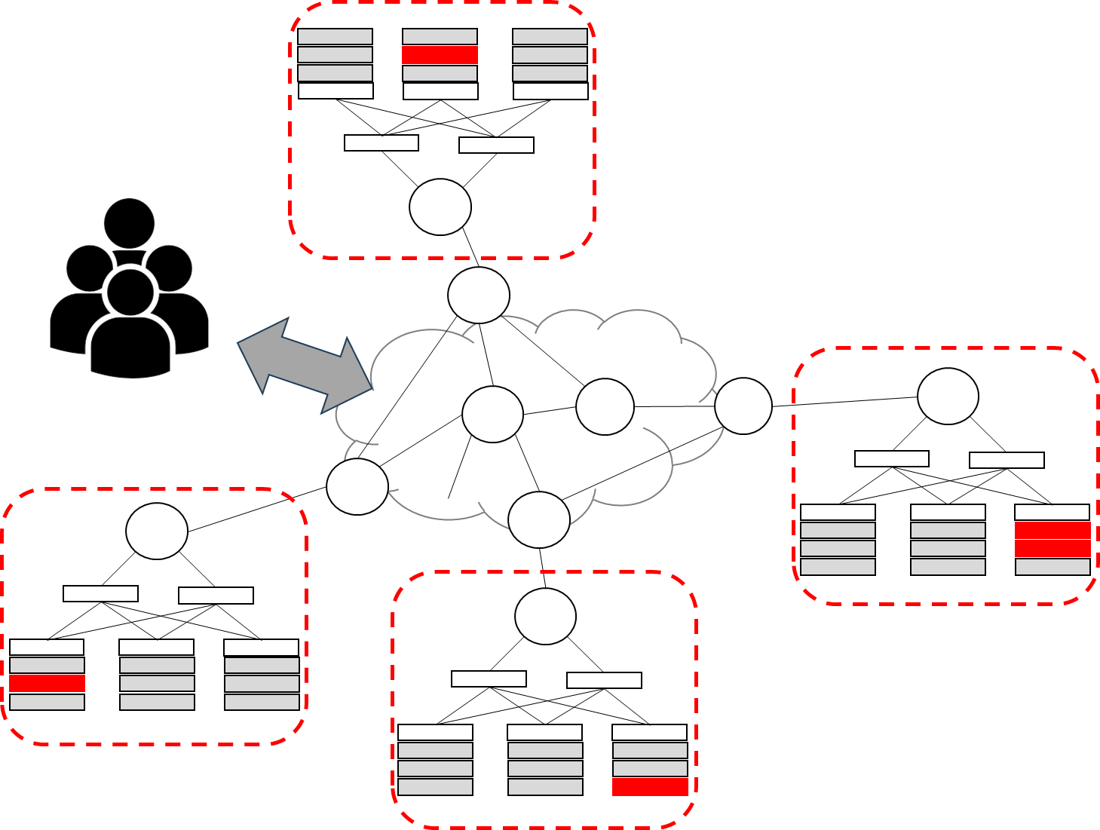
Scenarios in scope
Classical interconnection scenarios (peering, transit, internet exchanges)
Connection of CDN / content caches internal to the network
Interconnection of data centers (DC Gateway)
Cloud-edge continuum

Slide 3
Problem statement
The interconnection of domains is typically characterized by either large number of links or links of high capacity or both
Transition from 100 GE (or multiples of it) to 400 GE to 800 GE to 1,6 TE …
Network interconnections are increasingly becoming sensitive to sudden changes because of the large volume of traffic delivered through them
Unplanned operational situations motivate changes on traffic flows that can cause serious congestion internal to the network operator
Focus here is intra-domain and how network notification can assist on avoiding service affection
Inter-domain not covered at this stage

Slide 4
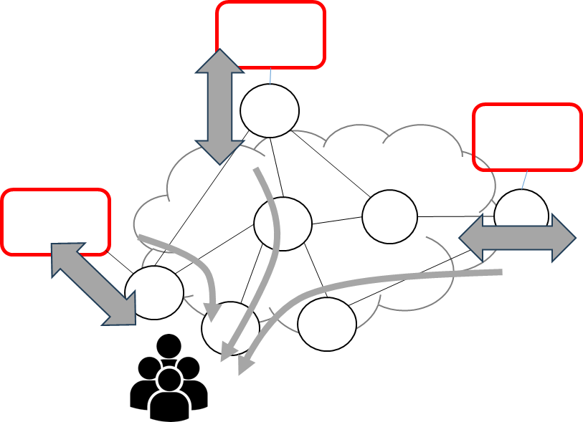
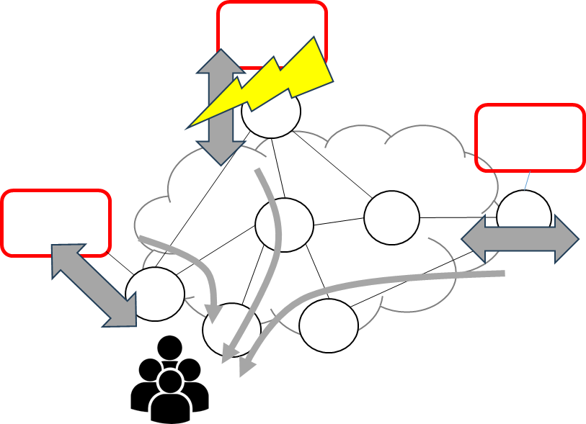
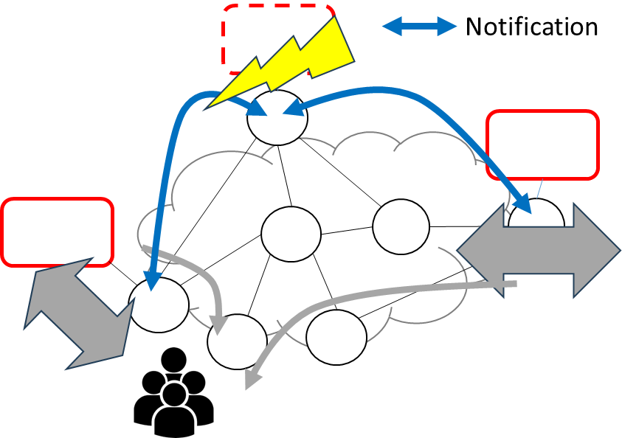
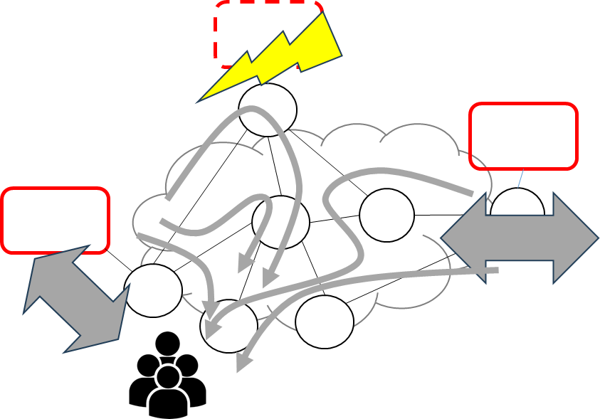
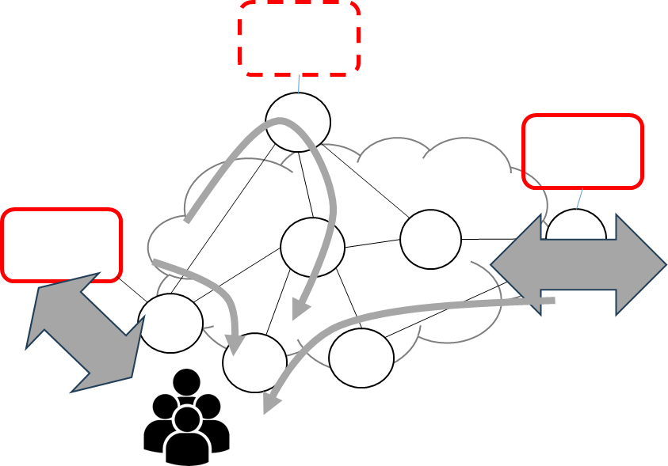
How Network Notifications could help?
1
Network Notification can trigger mitigation mechanisms to avoid traffic tsunami effect
E.g., direct notification among PE nodes can trigger actions on TE tunnels for accommodating sudden traffic flooding
Protocol timers for routing convergence could represent a graceful period where network notifications (and derived actions) could help
Pre-established policies or dynamic reconfigurations could avoid global effects
But this is part of the solution, so not for this discussion
2
3a
3b
4

